Slide 1

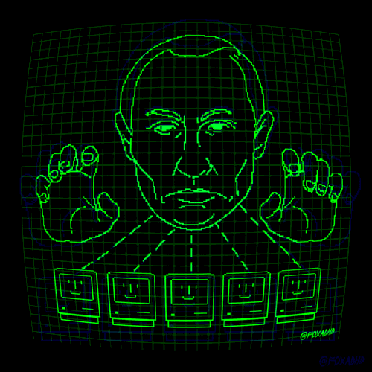
Do You Feel Safe ?

Slide 2
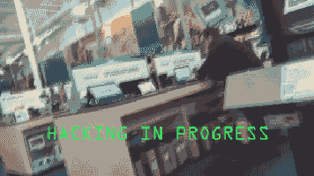






Problemas Abordados:
Scanning / mapping - nmap
XSS (Cross-site Scripting)
SQL injection
Reverse Engineering

Slide 3
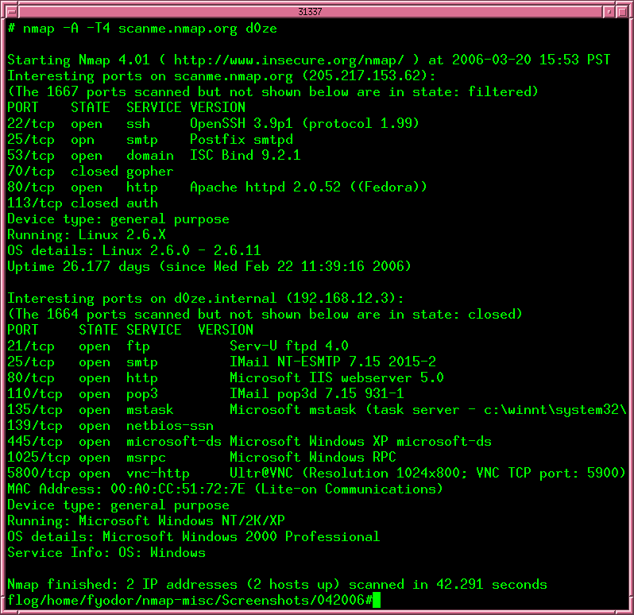
Scanning / mapping - nmap
The power of open ports

Slide 4


Slide 5
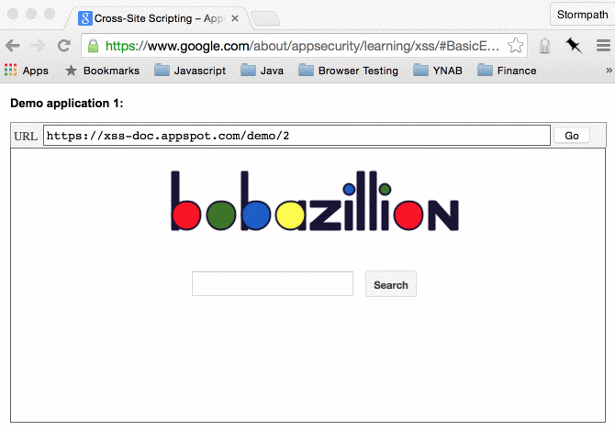
XSS (Cross-Site Scripting)
Persistente (Stored)
Refletido (Reflected)
Baseado no DOM (DOM Based)
https://xss-game.appspot.com/

Slide 7

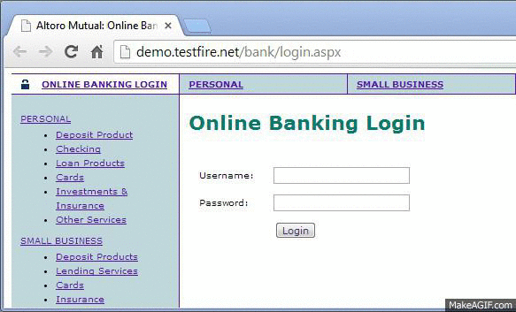
SQL Injection
In-band SQLi (Classic SQLi)
Inferential SQLi (Blind SQLi)
Boolean-based (content-based) Blind SQLi
Time-based Blind SQLi
http://demo.testfire.net/bank/login.aspx
http://web.ctflearn.com/web4/

Slide 9


Reverse Engineering

Slide 11
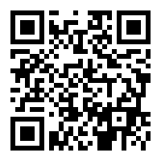





https://goo.gl/ucqaF6

